Slide 1

Customer invoice
COHORT ANALYSIS
3RD GROUP

Slide 2







MEET OUR
team
ANGGA SUKMA BD
KERIN M
YILMAZ TRIGUMARI
NABILA LAILINAJMA
TROY KORNELIUS
Head of Data Analyst
Data Analyst
Data Analyst
Data Analyst
Data Analyst
01

Slide 3

3RD GROUP
01
BACKGROUND
02
PROBLEM STATEMENT & GOALS
03
ANALYSIS
04
CONCLUSION & RECOMMENDATION
OUTLINE
Berikut adalah outline mengenai presentasi Cohort Analysis pada Customer Invoice:
02

Slide 4


BACKGROUND
Overview: Specialize in accounts receivable management for B2B transactions, ensuring timely payment collection and cash flow optimization.
Key Functions:
Invoice Management: Track and manage invoices issued to buyers.
Payment Collection: Collect payments for past due invoices.
Customer Communication: Send reminders and follow-ups for outstanding payments.
Cash Flow Optimization: Streamline the accounts receivable process for businesses.
Mission: To enable businesses to focus on their core operations while we handle payment collection and invoice management.
To ensure the company growth, the company’s marketing team wants to analyze the retention rate of the customers.
03
Notes:
About the Company
Company Overview: Our company specializes in accounts receivable management within the B2B landscape. We understand that businesses operate on credit, and the timely collection of payments is crucial for maintaining healthy cash flow and operational efficiency.
Key Functions:
Invoice Management: We assist seller businesses in tracking and managing invoices issued to buyer businesses. Each invoice contains essential details such as payment due dates, invoice amounts, and baseline dates.
Payment Collection: Our dedicated Accounts Receivable Department is responsible for collecting payments from customers for past due invoices. We ensure that businesses receive the funds owed to them for goods and services provided.
Customer Communication: We proactively send reminders and follow-ups to customers regarding outstanding payments, helping to facilitate timely cash inflow.
Cash Flow Optimization: By managing the entire accounts receivable process, we help businesses optimize their cash flow, ensuring they get paid for the products and services they supply.
Mission: Our mission is to streamline the accounts receivable process for businesses, enabling them to focus on their core operations while we handle the complexities of payment collection and invoice management.

Slide 5




PROBLEM STATEMENTS & GOALS?
How can a company improve its retention rate by analyzing customer retention trends over time?
Customer Patterns
Active Businesses
Relation
How do customer retention patterns or trends evolve over time?
How many businesses remain active after completing their first transaction or opening their first invoice?
Analyzing the relation of customer retention with currency, line of business, and customer payment terms.
04

Slide 6
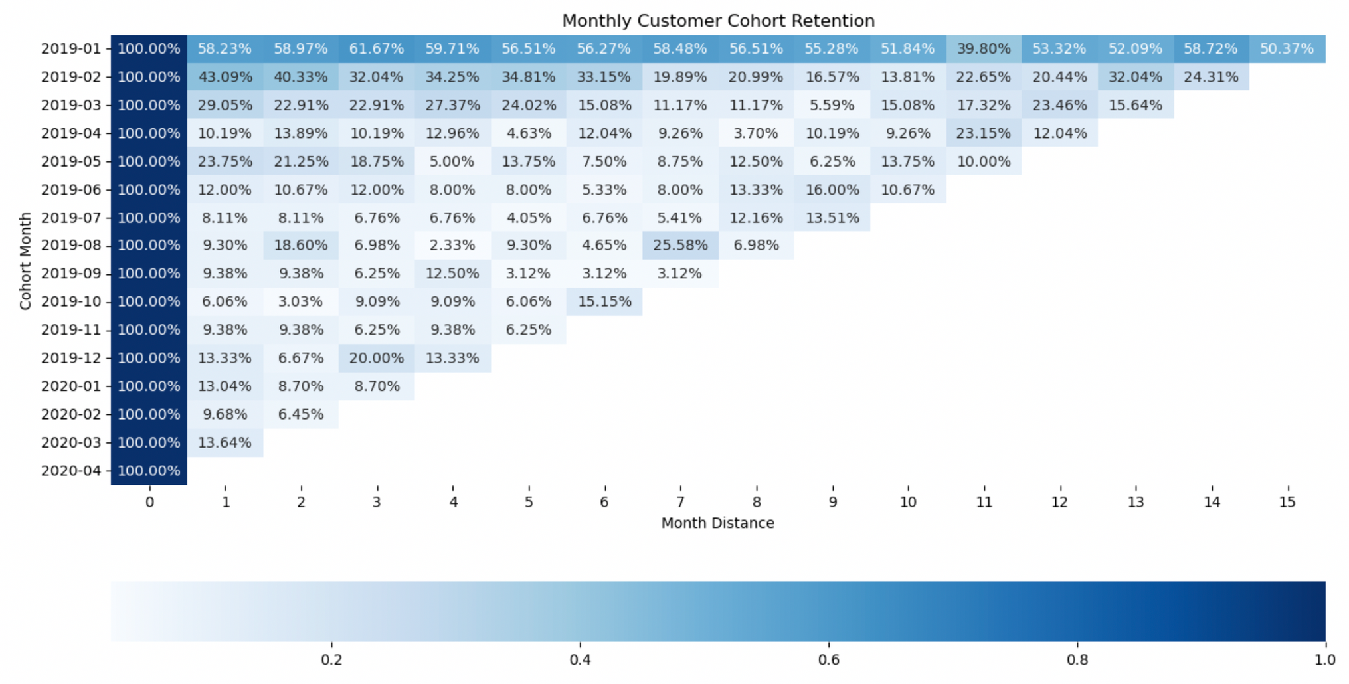
ANALYSIS COHORT HEATMAP
There was a significant decline in customer retention.
1
05

Slide 7
ANALYSIS COHORT HEATMAP
Many customers churned in the 9th and 12th months of 2019.
2
06

Slide 8
ANALYSIS COHORT HEATMAP
There was a slight increase in the 3rd month of 2020.
3
07

Slide 9
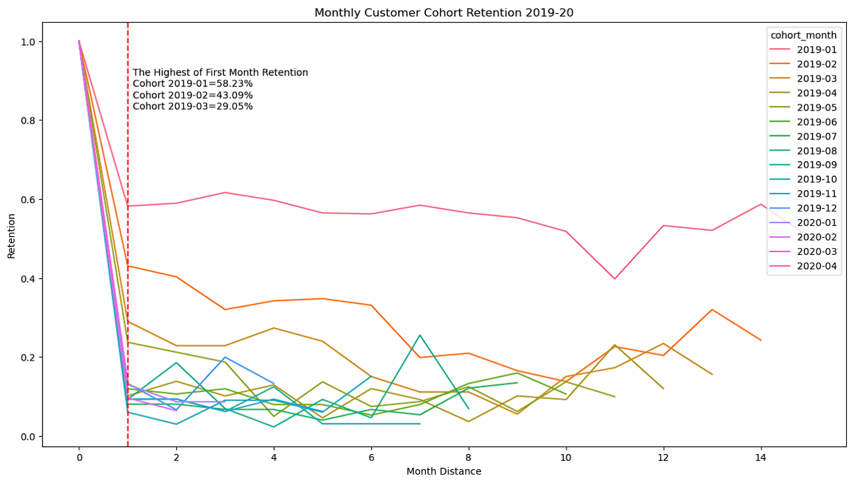
08
ANALYSIS COHORT LINEPLOT
The cohorts from January 2019, February 2019, and March 2019 show higher initial retention rates
1
compared to other cohorts.

Slide 10
09
ANALYSIS COHORT LINEPLOT
Customer retention decreases significantly over time since the start of the cohort.
2

Slide 11
10
ANALYSIS COHORT LINEPLOT
Many customers stopped using the service in the 9th and 12th months of 2019.
3

Slide 12
11
ANALYSIS COHORT LINEPLOT
There was a slight increase in retention in the 3rd month of 2020.
3

Slide 13
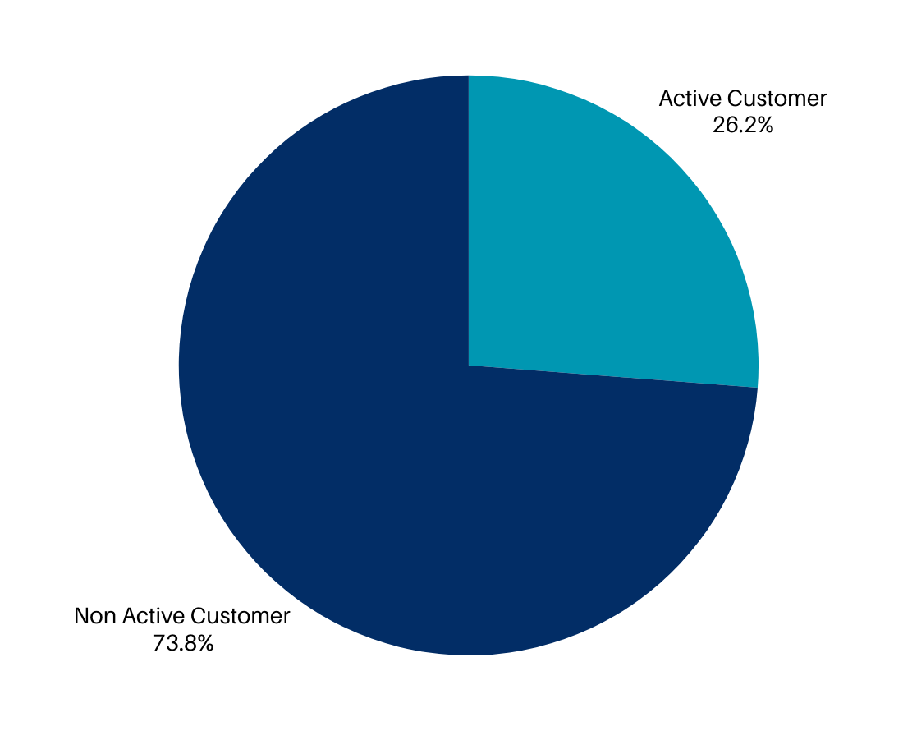
Total Customer :
1.380
PIEPLOT CUSTOMER
How many businesses remain active after completing their first transaction or opening their first invoice?
362
from 1.380 customers
12

Slide 14
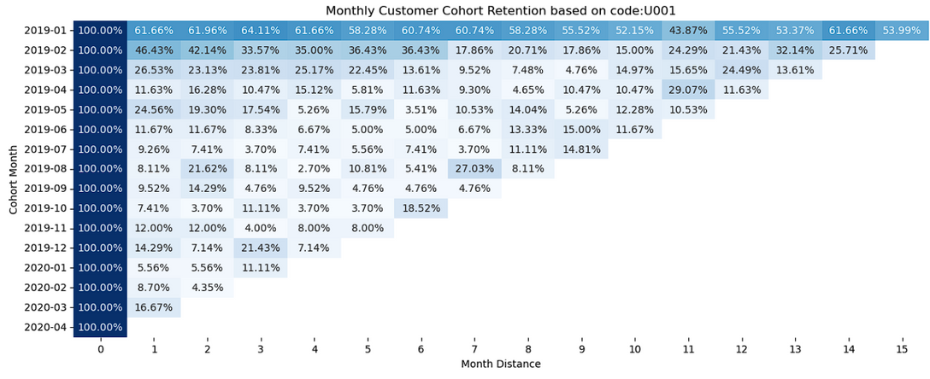
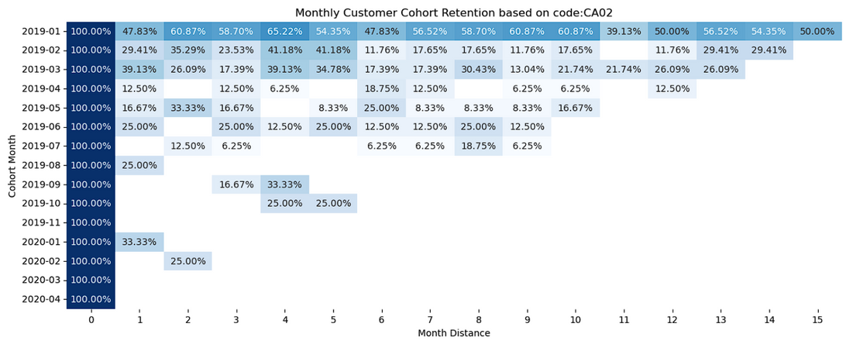
13
ANALYSIS RELATION CATEGORY
based on business_code
There are no significant difference in cohort retention based on business_code

Slide 15
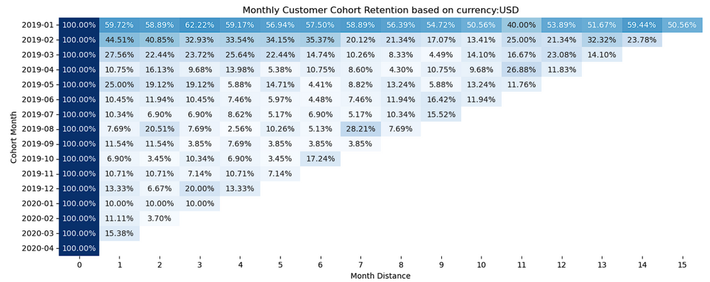
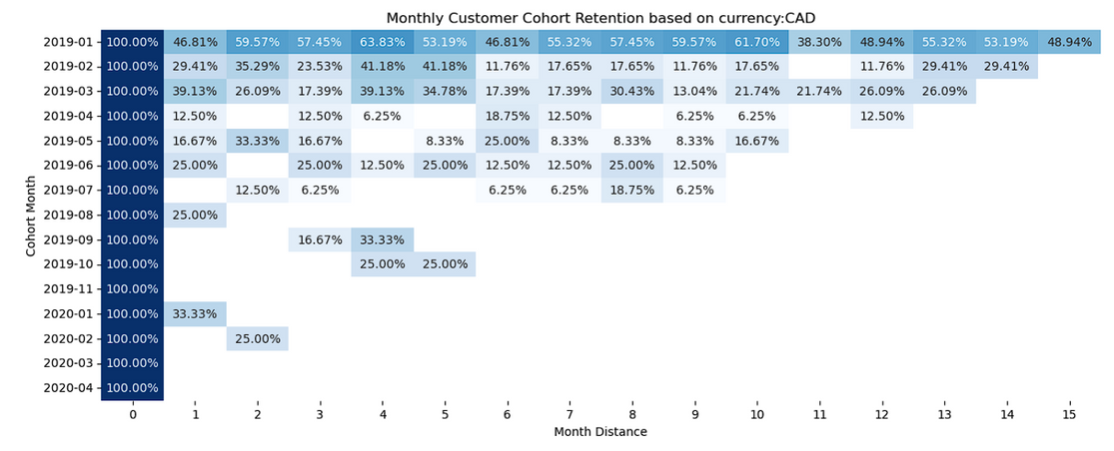
14
ANALYSIS RELATION CATEGORY
based on currency
There are no significant difference in cohort retention based on currency

Slide 16
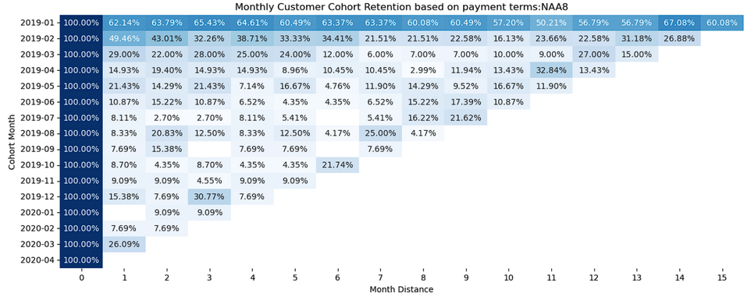
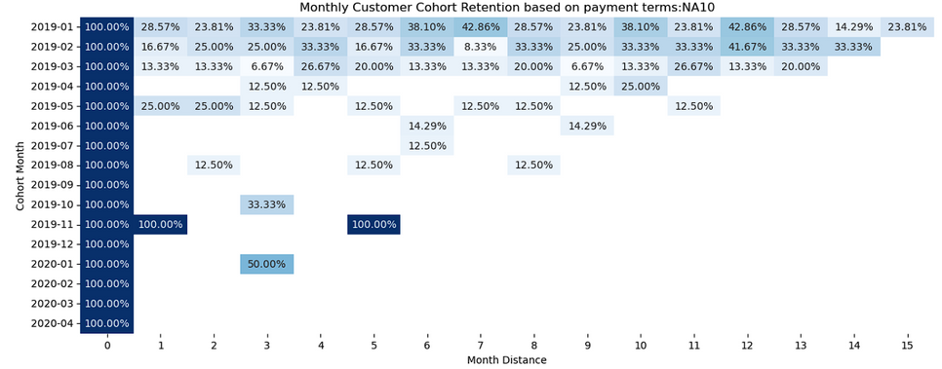
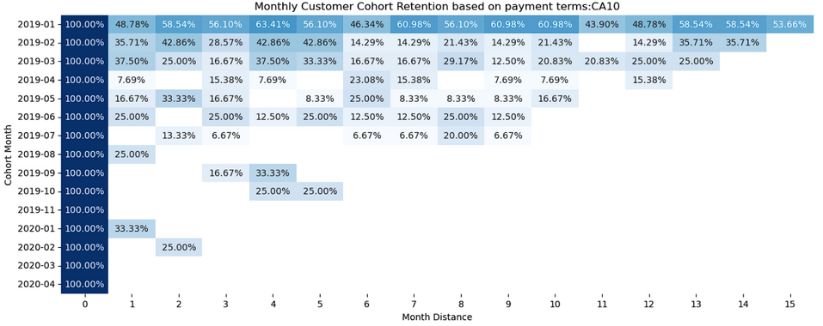
15
ANALYSIS RELATION CATEGORY
based on customer_payment_terms
There are no significant difference in cohort
retention based on customer_payment_terms

Slide 17
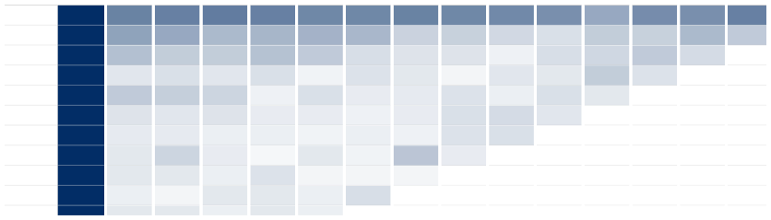
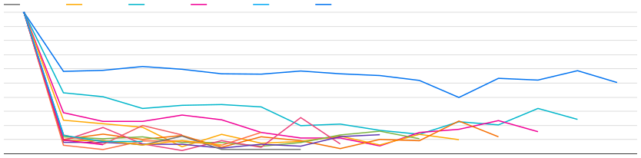
16
Total Customer
1,380
Active Customer
362
Percentage of Active Customer
26.23%
DASHBOARD
Cohort Retention Heatmap
period_distance / percentage
cohort_m… 2019-01 2019-02 2019-03 2019-04 2019-05 2019-06 2019-07 2019-08 2019-09 2019-10
0 100% 100% 100% 100% 100% 100% 100% 100% 100% 100%
1 58.23% 43.09% 29.05% 10.19% 23.75% 12% 8.11% 9.3% 9.38% 6.06%
2 58.97% 40.33% 22.91% 13.89% 21.25% 10.67% 8.11% 18.6% 9.38% 3.03%
3 61.67% 32.04% 22.91% 10.19% 18.75% 12% 6.76% 6.98% 6.25% 9.09%
4 59.71% 34.25% 27.37% 12.96% 5% 8% 6.76% 2.33% 12.5% 9.09%
5 56.51% 34.81% 24.02% 4.63% 13.75% 8% 4.05% 9.3% 3.13% 6.06%
6 56.27% 33.15% 15.08% 12.04% 7.5% 5.33% 6.76% 4.65% 3.13% 15.15%
7 58.48% 19.89% 11.17% 9.26% 8.75% 8% 5.41% 25.58% 3.13% -
8 56.51% 20.99% 11.17% 3.7% 12.5% 13.33% 12.16% 6.98% - -
9 55.28% 16.57% 5.59% 10.19% 6.25% 16% 13.51% - - -
10 51.84% 13.81% 15.08% 9.26% 13.75% 10.67% - - - -
11 39.8% 22.65% 17.32% 23.15% 10% - - - - -
12 53.32% 20.44% 23.46% 12.04% - - - - - -
13 52.09% 32.04% 15.64% - - - - - - -
14
58.72% 24.31%
- - - - - - - -
Lineplot Retention per Cohort
2019-01 2019-09
2019-02 2019-11
2019-03 2020-01
2019-05 2020-02
2019-04 2020-03
2019-06 2020-04
2019-08
2019-07
2019-12
2019-10
100 %
80 %
60 %
40 %
20 %
0 %
0
1
2
3
4
5
6
7
8
9
10
11
12
13
14
15
p eri o d _d i st ance

Slide 18
17
Conclusion
1
Early cohort months has higher retention rate compared to other months, especially in Sept and Dec 2019, then spike in Mar 2020.
2
26% of the total customers are still active, way below than the industry standard.
3
Retention of customer trend do not vary significantly with business_code, currency, and customer payment terms.

Slide 19
18
Recommendation
1
Conduct a deeper analysis to identify factors behind the high retention rate in early cohort month and the sharp decline in months 9 and 12.
2
Investigate external factors or policy changes that may have caused the drop and apply interventions like special offers or improved communication.
3
Strengthen successful strategies from month 3 of 2020 with incentives or promotions.
4
Continuously monitor and adjust strategies based on the latest data to improve customer retention.

Slide 20

Thank You.
Best Regards,
3RD GROUP.

